Slide 1

Department of Electronics & Communication
Engineering
PORTABLE SELF ASSESSMENT AUDIOMETER USING RASPBERRY PI
Batch No: B08
Domain: Embedded and IOT
Guided By: Mr.A.Shafeek AP(SS)/ECE
Review : 02
Presented By,
1. S.Naveen (727622BEC110)
2. S.Pranesh (727622BEC018)
3. M.Adhil (727622BEC114)

Slide 2
Contents
Introduction
Literature survey
Requirements
Block diagram
Flowchart
Weekly Plan
Work Completed for First & Second review
Work to be completed
References
Abstract
Problem Statement
Objectives
QR Code
Result
Conclusion

Slide 3
Introduction
Hearing loss is a common problem, especially for older adults.
It can make it hard to hear and talk to others.
Current hearing tests need a doctor and special rooms, which can be expensive and inconvenient.
This project created a portable hearing test anyone can use at home.
This could help people find out about hearing loss earlier and easier.

Slide 4
Problem Statement
The project aims to develop a portable audiometer for hearing self-assessment, addressing the limitations of conventional audiometers.
This cost-effective and user-friendly solution improves access to early detection and treatment of hearing loss, benefiting hearing-impaired individuals.

Slide 5
Objectives
Develop a portable audiometer for self-assessment.
Automate the hearing test process for efficiency.
Create a user-friendly interface using Python.
Generate accurate audiograms and store data effectively.
Notes:
e

Slide 6
Abstract
This study introduces a portable audiometer for self-assessment of hearing impairment, leveraging Raspberry Pi and Python. Users receive sound signals via headphones, responding with a patient button.
An automatic audiogram aids assessment, with results digitally stored. A familiarization process ensures user understanding, and the Hughson Westlake procedure enhances efficiency.

Slide 7
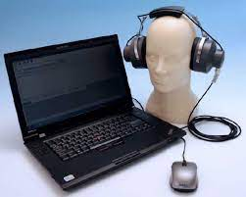
Abstract
Leveraging open-source Python minimizes software development costs. This innovative approach offers accessible and cost-effective hearing screening for elderly and hearing-impaired individuals.

Slide 8
Literature survey
Sl. No | Authors | Title of the paper | Journal | Year | Key points
1 | Ritu Rani; H.T. Patil | Portable audiometer for detecting hearing disorder at an early stage for cancer patient | IEEE | 2016 | Early detection, hearing loss,
2 | Marwa Gargouri; Mondher Chaoui; Patrice Wira | Development of hearing self-assessment pure tone audiometer | IEEE | 2020 | Self-test, hearing check, tones

Slide 9
Literature Survey
Sl. No | Authors | Title of the paper | Journal | Year | Key points
3 | M.Dharani kumar Chowdhary | A novel raspberry pi-3 based pure tone audiometer and verification of calibration with standard system | Journal of Data Acquisition and Processing | 2020 | Calibration, Raspberry Pi
4 | Silvia Figueira; Kevin Nguyen | HearThat? - An app for diagnosing hearing loss | IEEE | 2019 | Home test, Hearing check, App

Slide 10
Requirements
Raspberry Pi 3 B+
Mouse
Headphone
Raspberry pi OS & Python
Raspberry pi Case
HDMI to HDMI Cable
Ethernet Cable
USB Cable

Slide 11
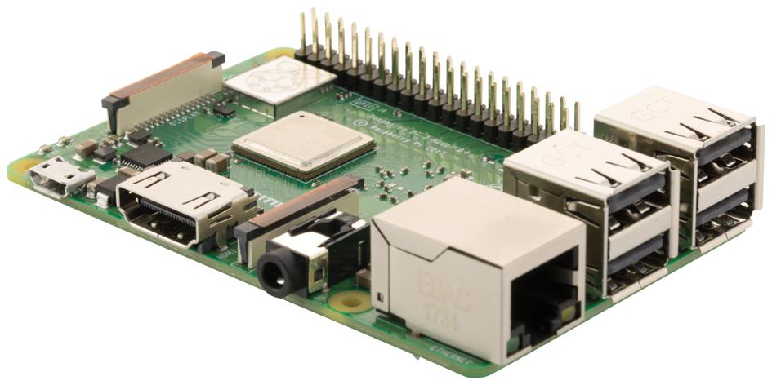
Tools to be used for implementing the project
Hardware:
Raspberry Pi 3 B+:
Interfaces with peripherals and runs the system.
Headphones:
Connected to the Raspberry Pi for delivering pure tone signals.
Mouse:
Connected to a USB port on the Raspberry Pi, used as the patient response button.

Slide 12
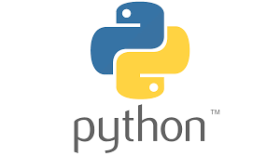
Tools to be used for implementing the project
Software:
Operating System: Runs on Raspberry Pi
Python Programming Language

Slide 13
Block diagram

Slide 14
Flowchart

Slide 15
Work Plan
Week Task | Week_1 (06.02.24 to 12.02.24) | Week_2 (16.2.24 to 23.2.24) | Week_3 (27.02.24 to 04.03.24) | Week_4 (05.03.24 to 12.03.24) | Week_5 (14.03.24 to 29.03.24) | Week_6 (30.3.24 to till now) | Status
Topic analysis |  |  |  |  |  |  | Completed
Objective& Abstract |  |  |  |  |  |  | Completed
Components Analysis |  |  |  |  |  |  | Completed
Design & Software installing |  |  |  |  |  |  | Completed
Learning Python |  |  |  |  |  |  | Completed
Coding & Result |  |  |  |  |  |  | In progress
Project completion |  |  |  |  |  |  | In progress

Slide 16
Work Completed for First review
Week Task | Week_1 (06.2.2024 To 12.2.2024) | Week_2 (16.2.2024 To 23.2.2024) | Week_3 (27.02.2024 To 04.03.2024) | Status
Topic Analysis |  |  |  | Completed
We have learnt about the project |  |  |  | Completed
PPT preparation |  |  |  | Completed
Parts procurement |  |  |  | Completed

Slide 17
Work Completed for Second review
Week Task | Week_4 (05.032024 To 12.03.2024) | Week_5 (12.03.2024 TO 29.03.2024) | Week_6 30.03.2024 To Till now) | Status
Components purchased |  |  |  | Completed
Installing raspberry pi OS |  |  |  | Completed
Coding & Output |  |  |  | In progress
Result |  |  |  | In progress

Slide 18
Results
We got the Raspberry Pi working, but there are still problems with the code. We've bought all the things we need, like the Raspberry Pi itself, a case for it, an HDMI cable, an Ethernet cable, and a USB cable.
However, we're still trying to fix the errors in the code. This is important because our project is about making a portable hearing test device, and we need the code to work correctly for it to function properly.

Slide 19
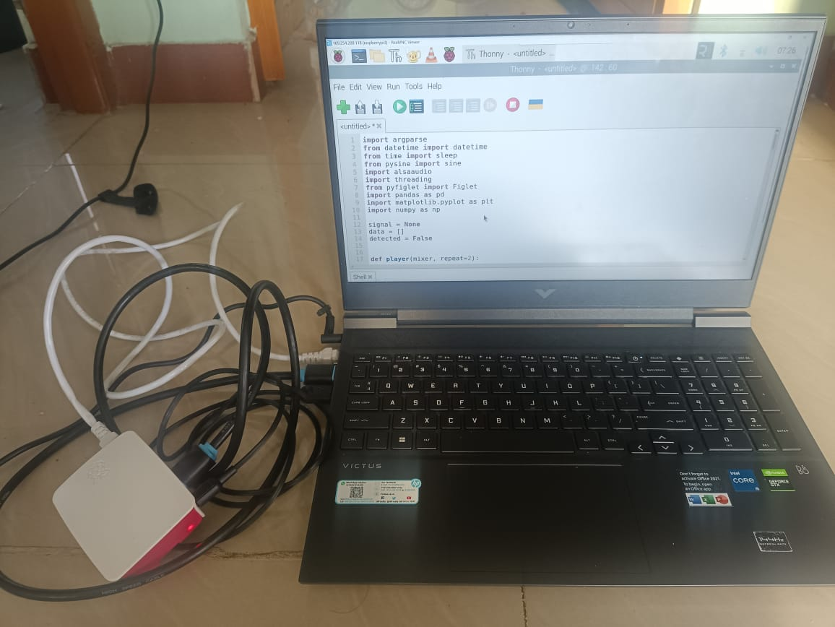
Results

Slide 20
Work to be completed
Week Task | Week_4 (05.032024 To 12.03.2024) | Week_5 (12.03.2024 TO 29.03.2024) | Week_6 30.03.2024 To Till now) | Status
Debugging or Error Resolution |  |  |  | In progress
Troubleshooting & Testing |  |  |  | In progress
Refinement & optimization |  |  |  | In progress
Result |  |  |  | In progress

Slide 21
Conclusion
Despite encountering errors in the code, the successful installation of the Raspberry Pi OS is a significant achievement. This project highlights the importance of perseverance in troubleshooting and refining the software.
With further debugging, the portable audiometer could become a cost-effective and accessible solution for hearing self-assessment, benefiting individuals with hearing impairment.

Slide 22
References
”Ritu Rani; H.T. Patil”, “Portable audiometer for detecting hearing disorder at an early stage for cancer patient”, “2016 International Conference on Automatic Control and Dynamic Optimization Techniques”.
“Marwa Gargouri;, Mondher Chaoui” ,“Development of hearing self-assessment pure tone audiometer, “2020 IEEE International Conference on Design & Test of Integrated Micro & Nano-Systems (DTS)”

Slide 23
References
“M.Dharani kumar Chowdhary, Dr. C. Nagaraja ”,” A novel raspberry pi-3 based pure tone audiometer and verification of calibration with standard system, “Journal of Data Acquisition and Processing(2020)”.
“Silvia Figueira; Kevin Nguyen; Shweta Panditrao”,
“HearThat? - An app for diagnosing hearing loss”, “IEEE Global Humanitarian Technology Conference (GHTC 2019)”.

Slide 24
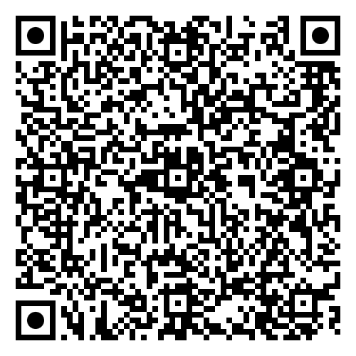
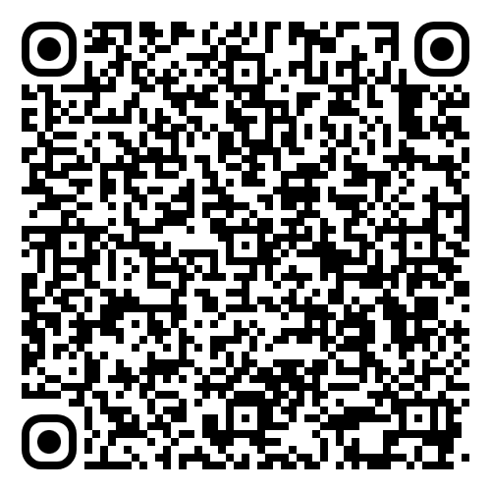
Scan the QR Code to view the Presentation & Research Paper on your Phone

Slide 25


